Slide 1
Search Relevance Testing:
QA in Machine Learning Models

Slide 2



vinayakamayura
vinayakamayura.gg@gmail.com
vinayakamayura
Vinayaka Mayura
Quality Analyst @ Thoughtworks

Slide 3
01
Search Relevancy
02
Machine Learning
Agenda
03
Challenges in ML Testing
04
Testing Techniques
05
How to become an ML Tester

Slide 4

Search Relevancy
Accurate
Best Results
Ranking

Slide 5







formal shoes
sneakers
Notes:
What is basically about Search Relevancy.
How important it is and Examples
Relevance is always Subjective
Differs from user to user
Most of the results are correct
There is no single right answer
It’s not just technical problem
Right results in Right Order
DCG - Discounted Cumulative Gain
Expected Reciprocal Rank

Slide 6
How search Relevancy works ?

Slide 7
Colour
Auto correction
Nike Blue colr running shoes for men
Brand
Article Type
Gender

Slide 8
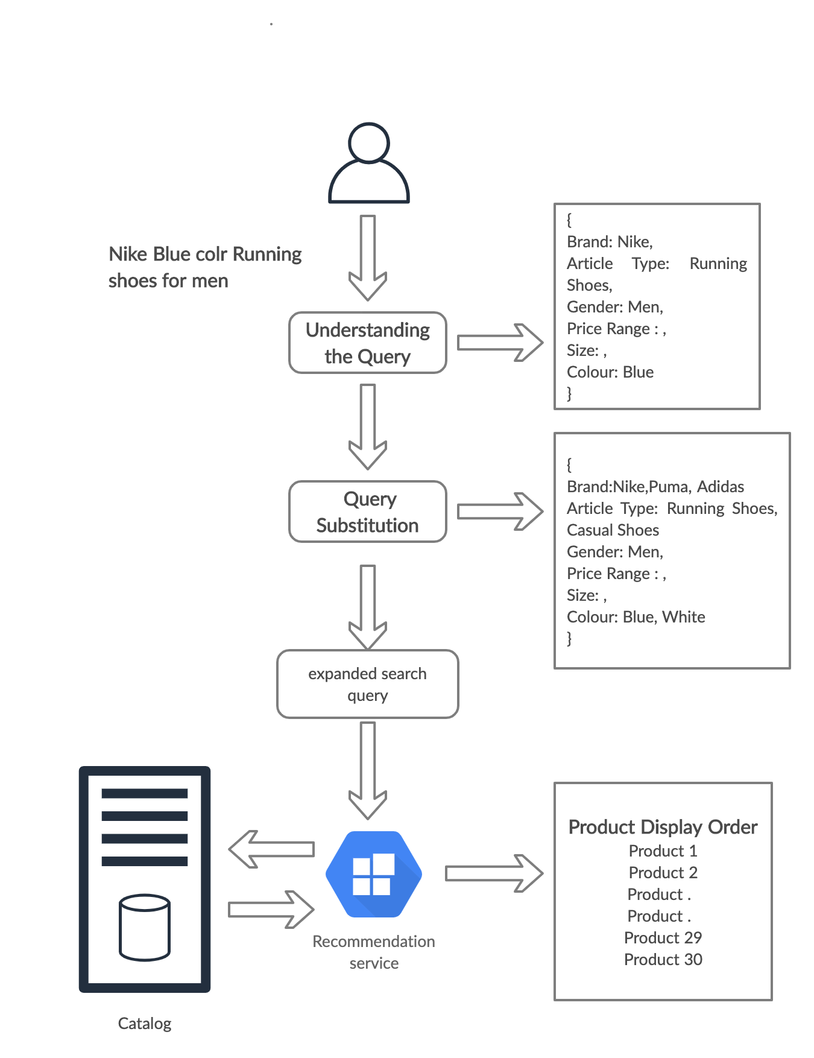

Slide 9
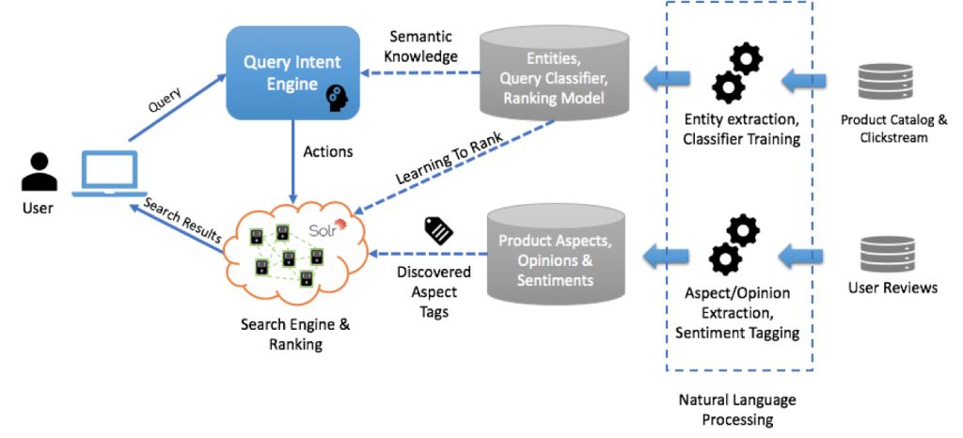

Slide 10
Machine Learning

Slide 11
Machine Learning Models
Ability to Learn
Mathematical Model
Logical / Natural thinking
Supervised Learning
Unsupervised Learning
ML Model != Algorithm
Training / Testing
Verification
Machine Learning is the field of study that gives computers the capability to learn without being explicitly programmed..

Slide 12
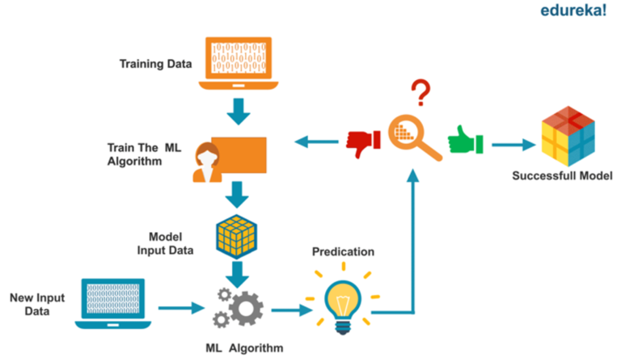
Building ML Model

Slide 13
Testing Properties
Correctness
Model Relevance
Robustness
Security
Data Privacy
Efficiency
Fairness
Interpretability

Slide 14
Challenges in Testing
Non Testable
Testing Oracle
Unknown Algorithms Implementation
Testing in Cross validation
Reliability
Future data is unknown
Test Adequacy
Fault Tolerance
Benchmarking
Behaviour for unpredicted data
Model Fairness
How to verify model is not biased
Release Management
Release Process
Notes:
Is this Relevant??

Slide 15
Machine Learning Life Cycle

Slide 16

ML Life cycle
Data
Features
Algorithms
Training
Backend Service

Slide 17
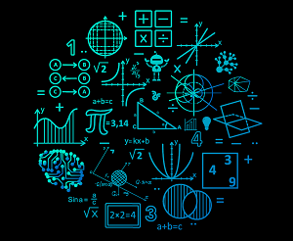

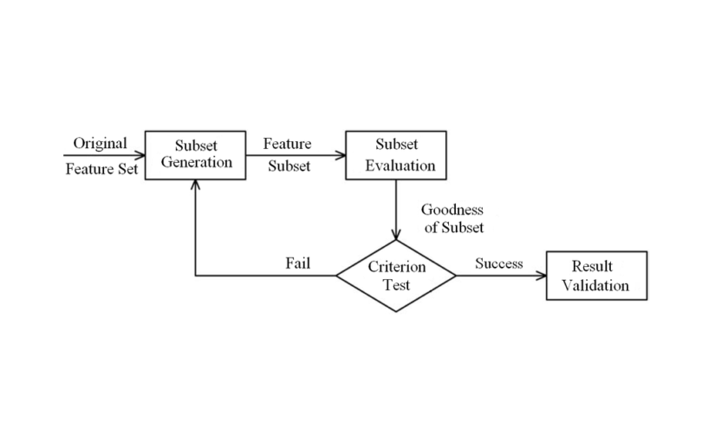
Components
DATA
FEATURES
ALGORITHMS

Slide 18
Data

Slide 19
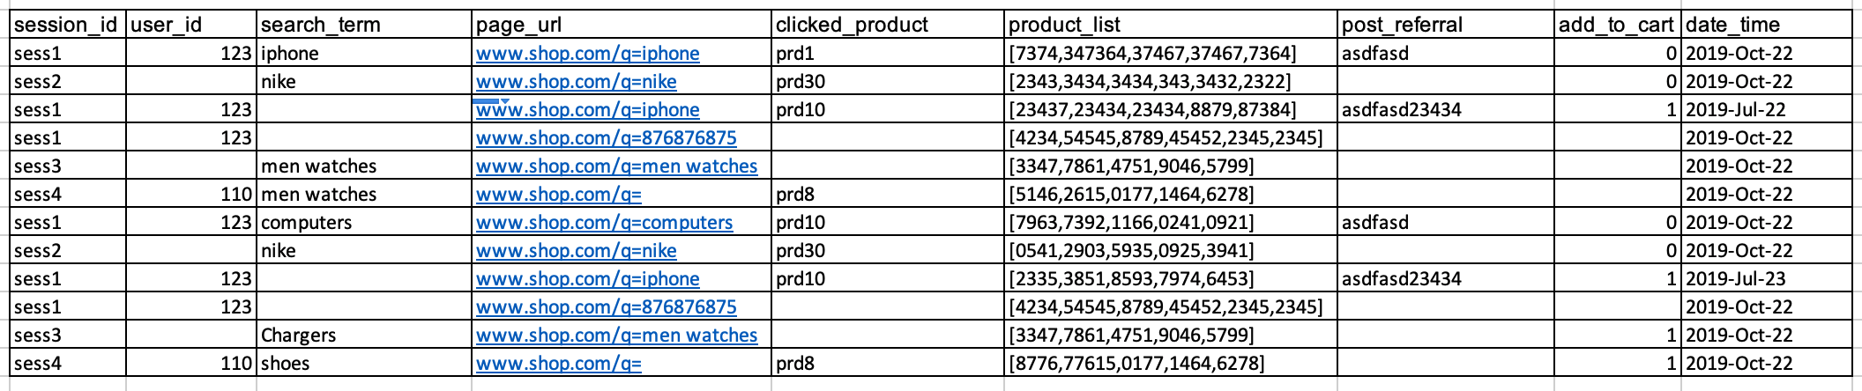
Browsing History
Notes:
Millions of Rows Every Day
Data will not be consistent
There are hundred of things tracked

Slide 20
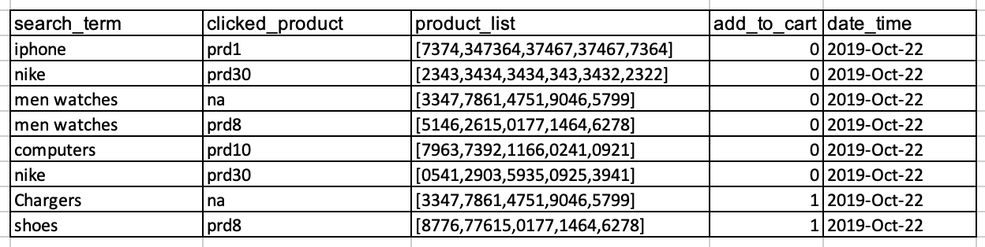
Data Cleaning

Slide 21
Data
Sanitise data
Adversary data set
Completeness
Correctness
Poisoning
Data for training
Notes:
Understand the statistics related with data (mean, median, mode etc)
Understand the data and their relationships at a high-level
Build tests (using scripts) to check the above statistics and relationships.
Run the tests at regular intervals

Slide 22
Features

Slide 23
Features
Feature Engineering
Measurable variable data
Column in dataset
Domain knowledge
Training Data
search_term | prod_id | impressions | clicks | add_cart
iphone | 278 | 10034 | 800 | 700
smart phone | 234 | 934 | 134 | 98
nike | 234 | 2344 | 532 | 50
smart phone | 192 | 2340 | 1198 | 1106
iphone | 363 | 1998 | 1864 | 1708
Shoes | 121 | 1 | 0 | 0
Notes:
Accurate Predictive
Reduces Irrelevant
Feature Selection
Threshold

Slide 24
Algorithms

Slide 25
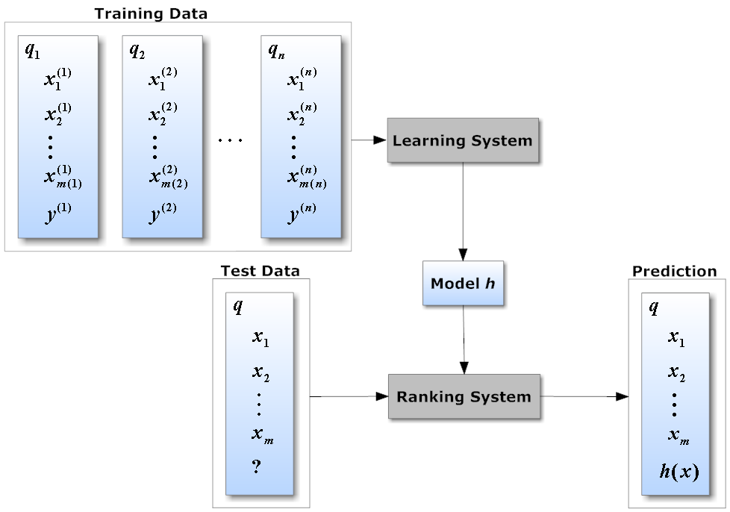
Algorithms
Mathematical Model
Implementation
Unit tests
NDCG
DCG
Mean Reciprocal rank
Precision

Slide 26
Testing Techniques

Slide 27
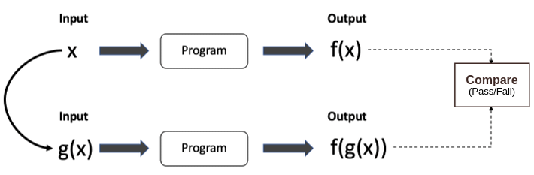
Metamorphic Testing
Test Oracle Problem
Metamorphic Relations
sin (x) = sin (π-x)
Coarse Grained data transformation
Fine Grained data transformation

Slide 28
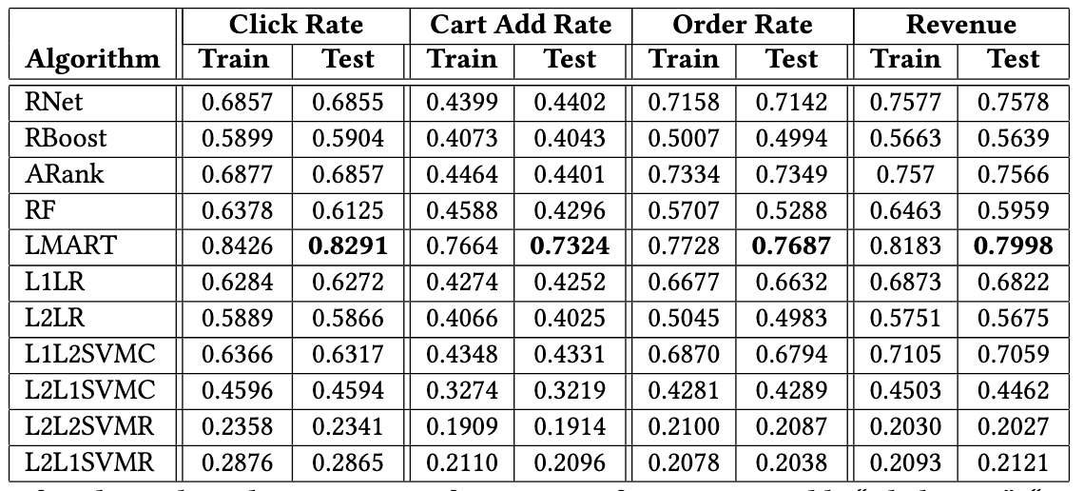
Dual Coding

Slide 29
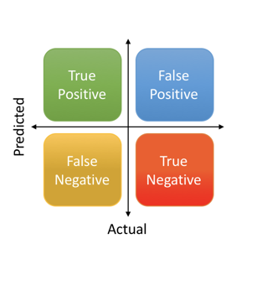
Precision and Recall

Slide 30

Mutation Testing
Original Data
Mutant Data
Introduce Fault
Original Data
Verify with both data
Mutant Data

Slide 31
Other Techniques
Fuzz and Search based Test Input Generation
Compare against Linear Regression
Test Adequacy
DeepXplore
Testing with different dataset

Slide 32
Software Testing v/s ML Testing
Characteristics | Traditional Testing | ML Testing
Components to Test | Code | Data and Code
Behaviour under Test | Fixed | Changes over time
Test oracle | known | unknown
Adequacy Criteria | Coverage | unknown
False positive | Rare | Prevalent
Tester | Dev / QA | DS / Dev / QA

Slide 33
How to become a ML Tester
Domain understanding
Programming knowledge
ML Courses
Datascience
Sample projects in Kaggle
Scholarly Articles

Slide 34
Reference
[1] Jie M. Zhang, Mark Harman, Lei Ma, Yang Liu. Machine Learning Testing:Survey, Landscapes and Horizons, ACM 2017
[2] https://tech.wayfair.com/
[3] Scholarly Articles about ML
[4] Machine Learning Course in Youtube
[5] Machine Learning Mastery
[6] https://vitalflux.com/category/machine-learning/
[7] MIT ML
[8] https://towardsdatascience.com/
[9] https://www.edureka.co/blog/data-science-vs-machine-learning/

Slide 35
Thank You

